Slide 1
Dysregulation of gene expressions upon Zika virus infection
Yonghua Zhuang
12-16-2016

Slide 2
Zika virus (ZIKV)
First identified in Zika forest, Uganda in 1947;
Mosquito-borne flavivirus;
Transmitted majorly by daytime-active mosquitoes;
Related to dengue, yellow fever, and West Nile viruses;
Often causes no or only mild symptoms;
No vaccine or effective treatments available.
Notes:
Gene is a molecular unit that can be inherited

Slide 3
Microcephaly and ZIKV epidemic

Slide 4
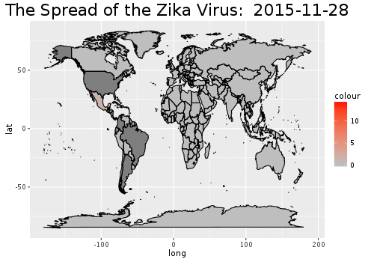
Rob Harrand

Slide 5
ZIKV epidemic and microcephaly
ZIKV infection was linked to microcephaly among newborn infants;
Zika virus infects human cortical neural progenitors and attenuates their growth;
Zika virus disrupts neural progenitor development and leads to microcephaly in mice.

Slide 6
Question
How dose ZIKV infection trigger cell death in the brain?
What genes are involved?
What gene sets/signaling pathways contribute cell death?
Global transcriptome analysis: RNA sequencing data

Slide 7
Data
Subjects: 2 uninfected and 2 ZIKV infected mice;
Infect E14.5 embryo brain with ZIKV and harvest brain 3 days after;
Sequencing data mapping to mouse GRCm38 (mm10) reference genome using Bowtie2;
All experiment done at University of Georgia;
BAM files available on PubMed (SRR4445640 - SRR4445643).
Shao Q et al., Development. 2016 Nov 15;143(22)

Slide 8
Method
BAM file
Raw counts
exploratory analysis
differential
expression
rlog transformation
DESeq2
edgeR
BH multiple testing correction
PCA analysis
GO term enrichment analysis

Slide 9
DESeq2
"regularized log" (rlog) transformation method: behave similarly to log2 transformation for genes with high counts; shrink together the values for different samples for genes with low counts.
Estimates dispersion by incorporating data-driven prior distributions;
Size factors were determined by using the "median ratio method”;
Tests differential expression on raw count data: negative binomial generalized linear models.

Slide 10
edgeR
Size factors were estimated using the "trimmed mean of M values (TMM)" method on log2 scaled count data.
TMM method is simple but robust way to estimate the ratio of RNA production;
Test differential expression using Fisher exact test.
The edgeR method seems to be anti-conservative for lowly expressed genes and might have higher type-I error than DESeq2.

Slide 11
Gene ontology (GO) term enrichment analysis
A technique for interpreting sets of genes making use of the Gene Ontology system of classification;
Genes are assigned to a set of predefined bins depending on their functional characteristics.
Function and pathway analyses based on the association of GO terms to genes in a selected gene list are useful.

Slide 12
Result

Slide 13
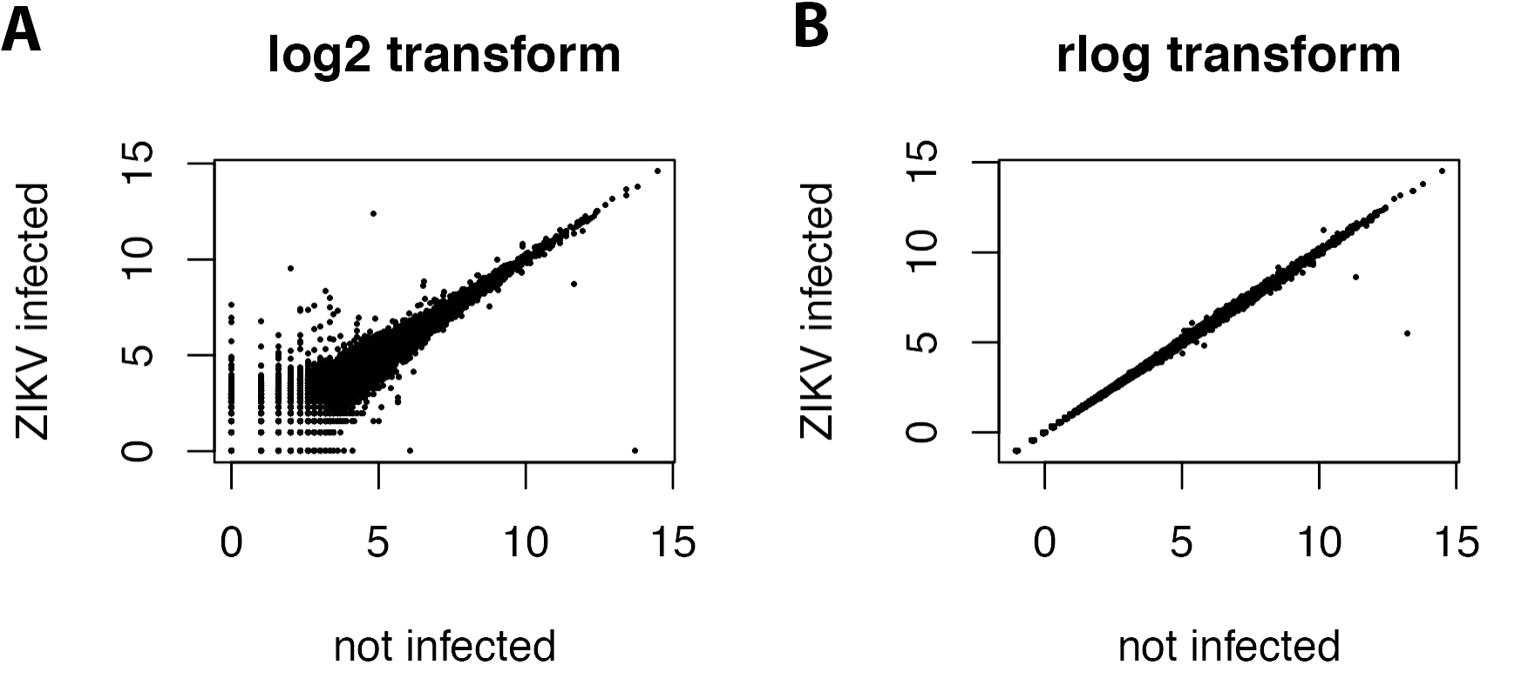
Exploratory analysis and visualization
The genes with low counts seem to be excessively variable on the ordinary logarithmic scale.
The rlog transformation suppress variation for the low count genes.

Slide 14
Principal components analysis (PCA)
The differences between not infected and ZIKV infected samples are large;
There were variations within each group.

Slide 15
Significant differentially expressed genes identified by DESeq2
Many genes are up-regulated upon ZIKV virus infection while little genes were down-regulated.

Slide 16
Method comparison: DESeq2 vs. edgeR
FDR <= 0.05
padj <= 0.05

Slide 18
Gene expression level and cluster analysis

Slide 19
Gene Ontology enrichment analysis

Slide 20
Summary
We found 59 significant differentially expressed genes in both methods;
Most of significant differentially expressed gene were up-regulated upon ZIKV infection;
ZIKV infection activate immune response, interferon response, glutamate toxicity and histone modification;
Aggressive cellular response including immune response, interferon response could limit ZIKV growth but also cause brain damage by triggering neuronal death.

Slide 21
Limitations
The sample size was too small;
There were large variation within each group;
The samples were only collected at one time point: 3 days after ZIKV infection.
Massive neuron death occurred 10 days after ZIKV infection;
ZIKV kept growing to the end of experiment (10 days after infection);
Highly possible that many gene expression changes might not occur yet after 3-day infection.

